Slide 1
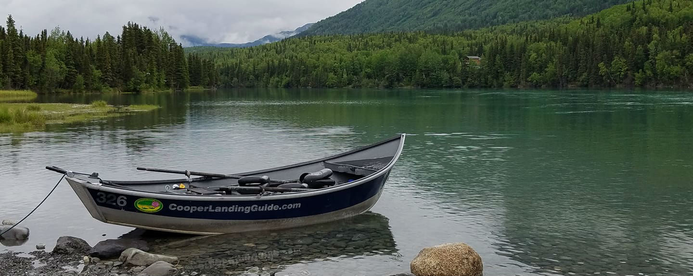






THE LAST FRONTIER COLLECTION CLUB

Slide 2
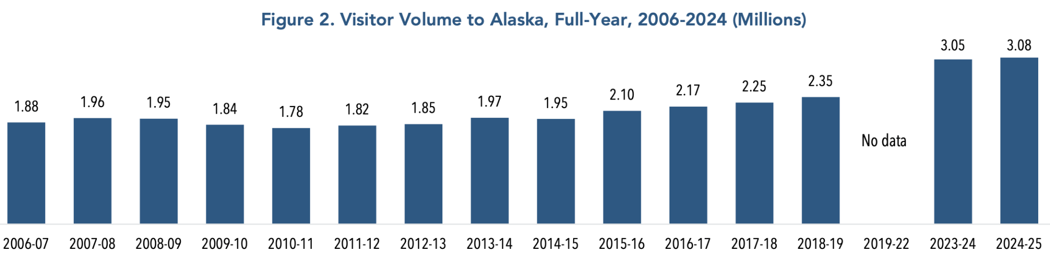
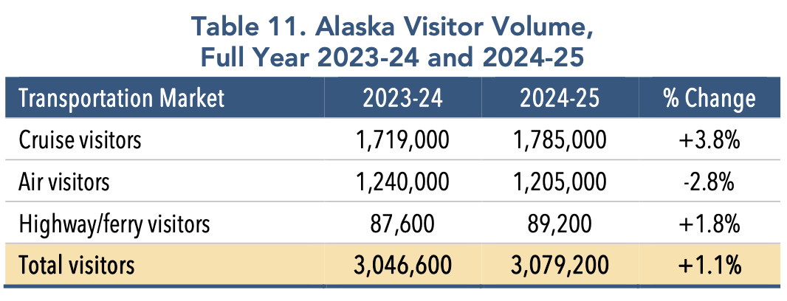
MARKET OPPORTUNITY - THE KENAI: ALASKA’S PLAYGROUND
30-35% of Total Alaska Visitors will visit Kenai Peninsula
923,760 - 1,077,720 Kenai Peninsula Visitors Annually
2 MAJOR CRUISE TERMINALS
1 HOUR DRIVE FROM INTERNATIONAL AIRPORT

Slide 3
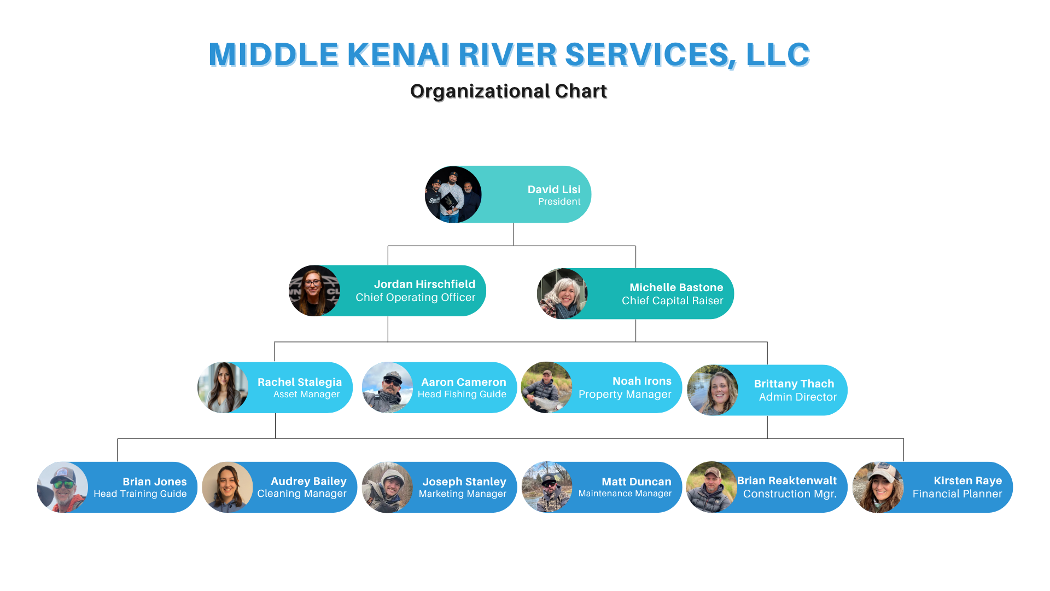
OUR TEAM

Slide 4
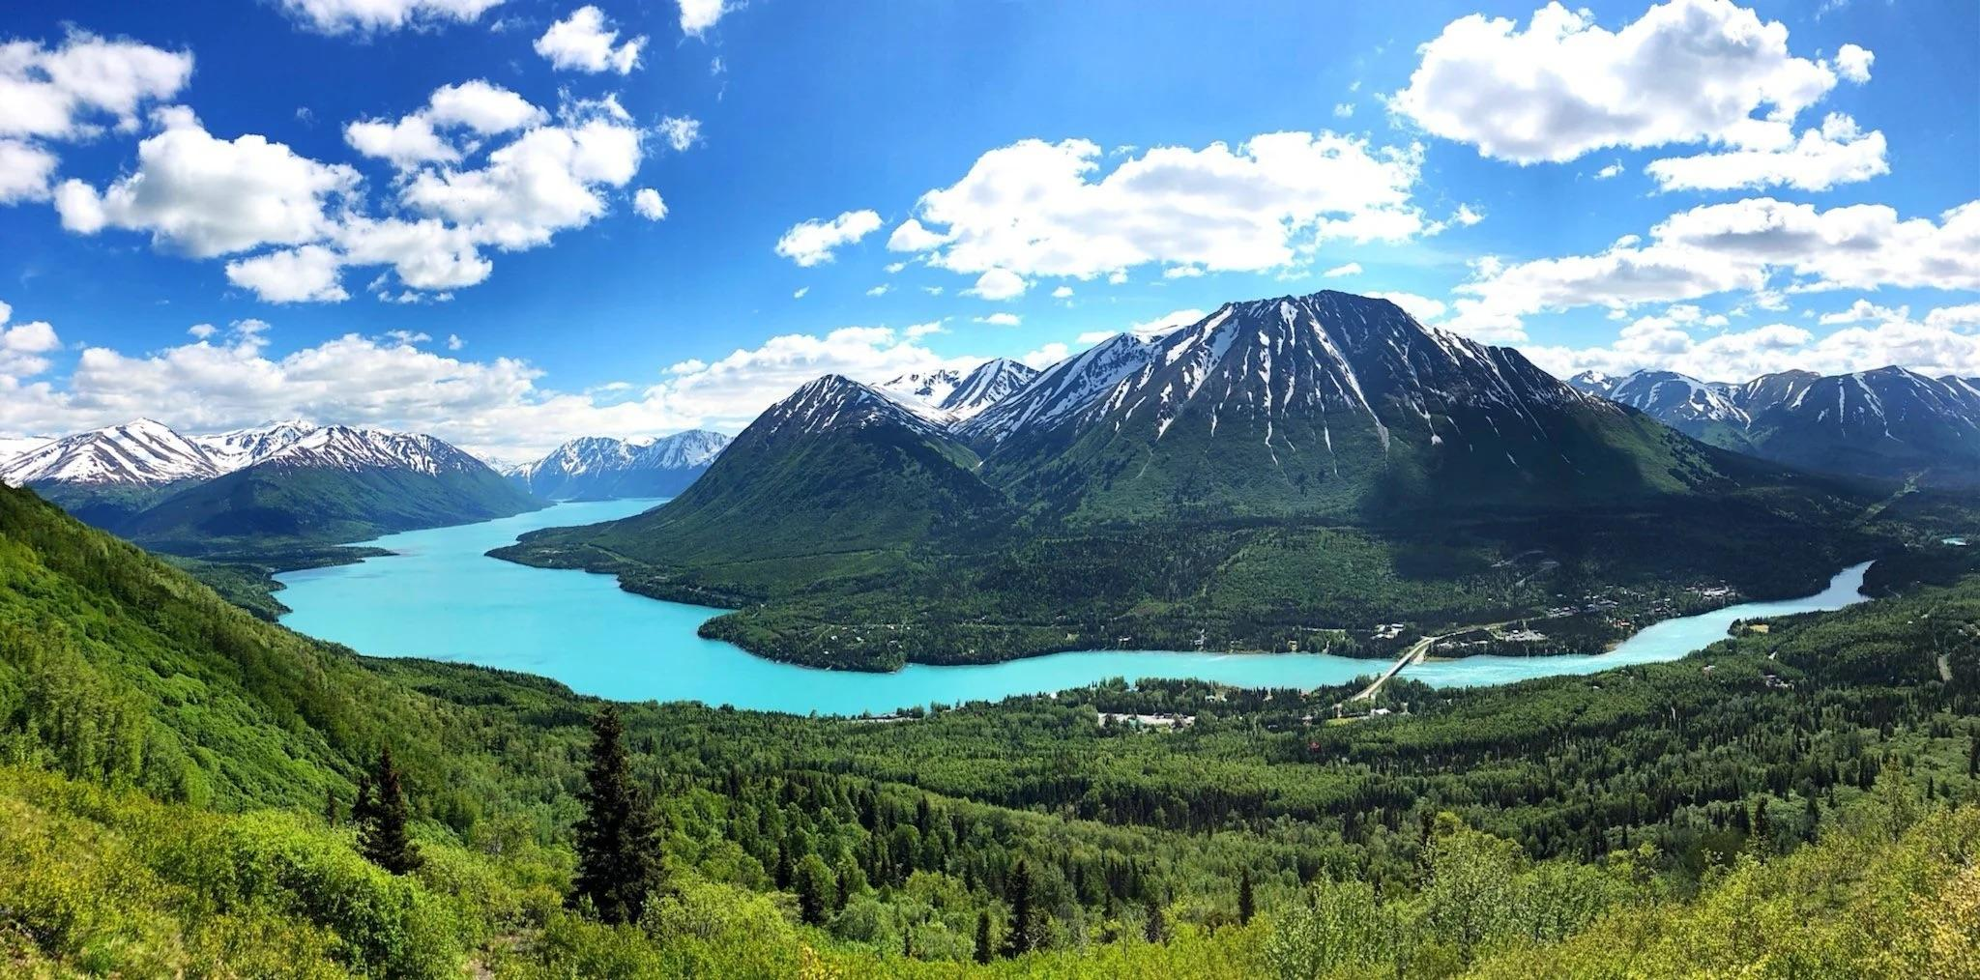
THE ECOSYSTEM
VERTICALLY INTEGRATED TOP OF THE FUNNEL MODEL
4,500-5,000 Annual Fishing Clients (Top of Funnel)
Funnel into our properties & experiences
1,000 Clients (AirBnb, VRBO - Lodging Clients)
Funnel into other lodging & experiences we own
CAPTURE THE TRAVEL ROUTE OF OUR CLIENT POOL

Slide 5
INVESTMENT OPPORTUNITY
CLUB PROFILE & CRITERIA

Slide 6
WHAT PROBLEM AM I SOLVING?
Fragmented Booking Atmosphere
Archaic Websites
Lodge & Excursion Business Owners Not Answering
Daunting Itineraries (Lots of Driving, etc.)

Slide 7
TRACTION: PROOF OF CONCEPT
Years in Operation (2026)
10th Year for Cooper Landing Fishing Guide
4th Year for Lodge Properties
NOI 2024: $971,072 ($250,000 Profit)
NOI 2025: $1,050,000 ($300,000 Profit)
PROJECTED TOTAL NOI 2026 (w/no changes to structure): $1,200,000 ($360,000 Profit)
PROJECTED PHASE 1 NOI 2026 $470,000 (30% Profit/28% COC) & $104,000 Debt Savings (Asset Value $4,375,000)
PROJECTED PHASE 2 NOI 2026 (w/lodging/fishing acquisitions): $7,500,000
Total Website Stats (not including 3rd party marketing)
AHL (Lodging) - 2025 YTD 22,482 (32% increase from 2024)
CLFG (Fishing) - 2025 YTD 92,000 (Steady Traffic Year over Year - 2024: 102,000 Visitors)

Slide 8

THE ASK
PHASE 1 Raise $1.63m - ($500k Minimum)
$200k Purchase Jellyfish Ave Property
$180k Debt Conversion - Brenda Way Property
$300k Debt Conversion - Blakley Ct. Property
$150k Executive/Admin Hire Cushion, Holding Costs, TC Fees, Capatalize LLC
$800k Refi Interest-Only Debt - Blakley Ct. (Convert 1m of Debt to 1st Position Security)

Slide 9
LAST FRONTIER COLLECTION CLUB
TIMELINE - 2 YEARS (Aquisitions, Debt Conversion & Executive Hires)
MINIMUM INVESTMENT - $25,000
MINIMUM RAISE - $500,000
TARGETED RAISE - $1,630,000
EQUITY - 20%
ANNUALIZED RETURN - 7%

